Slide 1
Fundamentals of
Instruction

Slide 2
Topics
Human behavior
The learning process
Effective communication
The teaching process

Slide 3
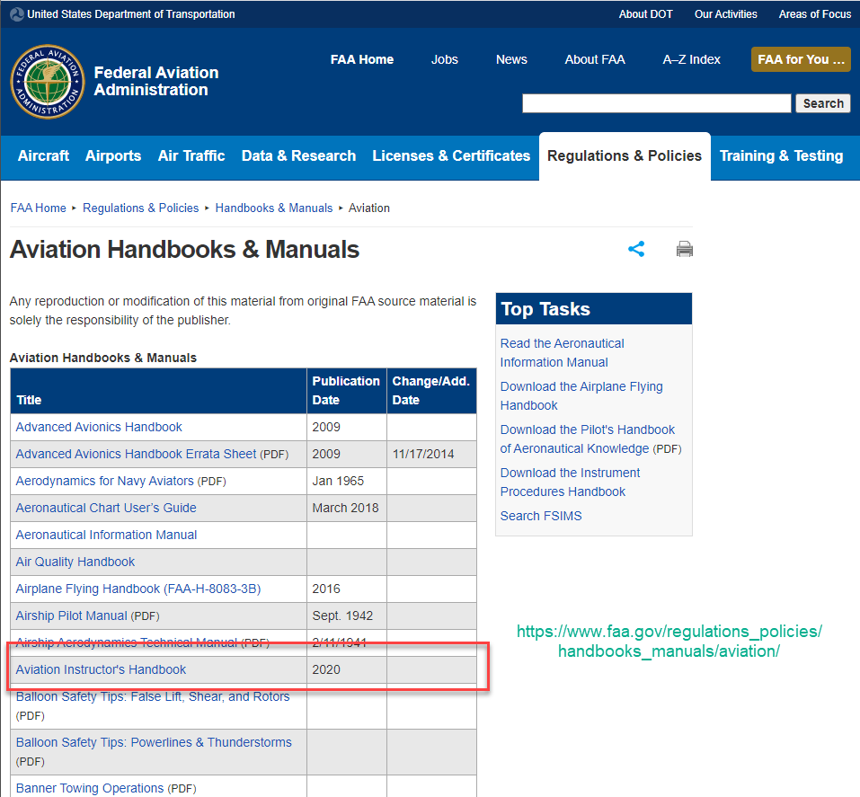

Slide 4
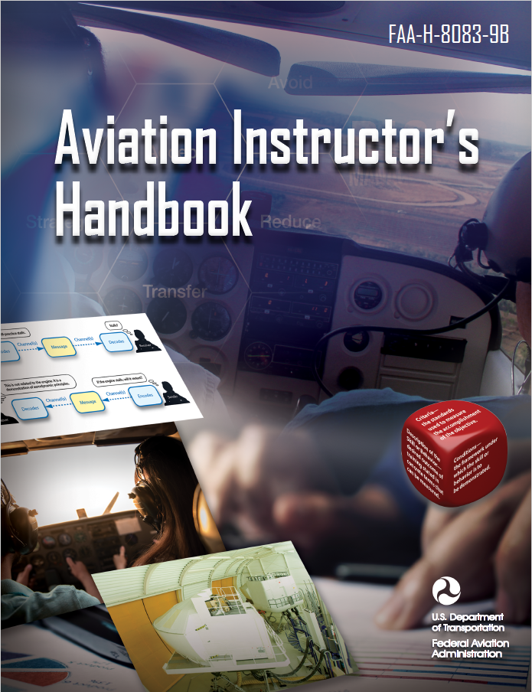
Chapter 2:
  Human Behavior
Chapter 3:
  The Learning Process
Chapter 4:
  Effective Communication
Chapter 5:
  The Teaching Process

Slide 5
Human Behavior

Slide 6
Human Behavior: Definitions
Attempt to explain how and why humans function the way they do
Product of innate nature, experience, and environment
Result of attempt to satisfy needs
Predictable “life stages” or “phases of growth”

Slide 7
Personality types
Theory that your personality type affects your preferred learning style
Controversy around particular methods of categorizing types (Myers-Briggs Type Indicator)
Implemented at many levels of education

Slide 8
Motivation for Learning
Motivation is the dominant force that governs a student’s progress
Instructors who can discover what motivates a student can facilitate progress towards goals

Slide 9
Maintaining Motivation
Reward improvement by
  Praising incremental success
  Relate daily accomplishments to lesson objectives
  Comment favorably on student progress and ability
  Pair success with new challenges

Slide 10
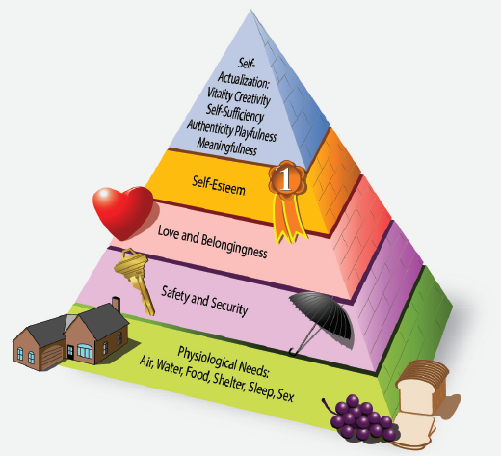
Human
Needs and
Motivation

Slide 11
Maslow’s Hierarchy of Needs
Needs are hierarchical – the ability to concentrate on needs at the top of the pyramid depends on the lower levels being adequately supplied.

Slide 12
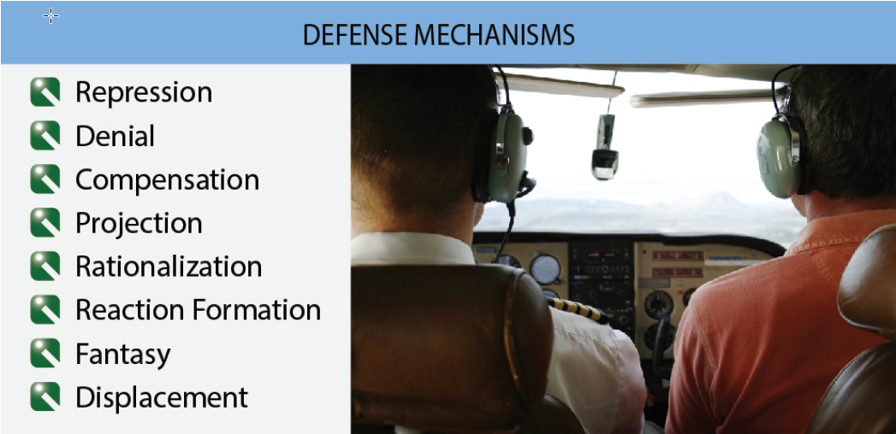

Slide 13
Learner Emotional Reactions
Anxiety
Impatience
Flagging interest
Physical discomfort
Apathy

Slide 14
Reactions to Stress
Normal
Abnormal
Activation of “fight or flight” syndrome
Rational response
Rapid action
Heightened sensitivity to environment
Responses will be largely automatic, which highlights need for training in emergency operations
Inappropriate reactions
  Laughter or singing
  Extreme cooperativeness
  Painstaking self-control
Marked mood changes
Anger

Slide 15
Teaching the Adult Student
Learning is means to end
Autonomous and self-directed
Draw upon reservoir of experience
Goal oriented
Relevancy oriented and practical
Desire respect and self-esteem
Want to solve problems and apply new knowledge immediately

Slide 16
The Learning Process

Slide 17
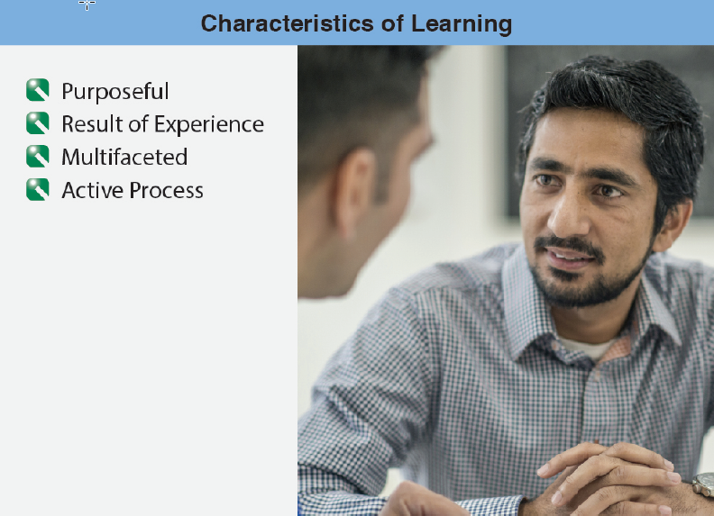

Slide 18
Theories of Learning
Behaviorism
Cognitive Theory
Observable and measurable responses to stimuli
Rewards and punishments (carrot and stick)
Positive reinforcement – instructor reinforces good performance with praise
Process of thinking and learning
Not just change in behavior, but in the way the learner thinks and understands
Concerned with mental events

Slide 19
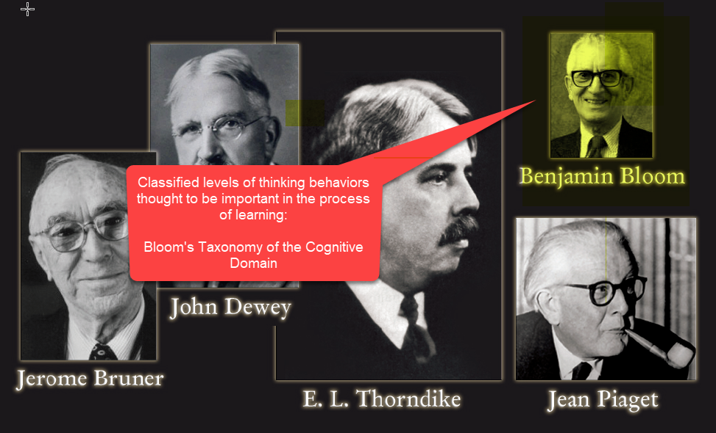
Pioneers of Cognitive Theory

Slide 20
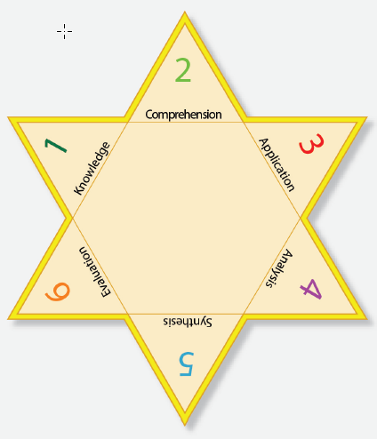
Bloom’s Taxonomy

Slide 21
Acquiring Knowledge

Slide 22
Steps of Acquiring Knowledge
Memorization
  Learning facts
Understanding
  Making associations
  Noticing similarities
Application
  Using new knowledge to expand

Slide 23
Memorize
A student pilot correctly recites the memory items for an engine failure after takeoff
Understand
The student explains why we use a best glide speed during an engine failure
Apply
During simulated engine failure at 500 feet AGL, the student immediately applies the proper memory items and sets up for a landing in a suitable field

Slide 24
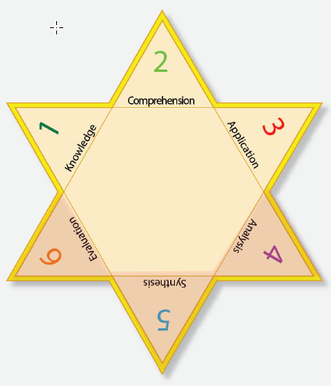
Higher Order Thinking Skills (HOTS)

Slide 25
Higher Order Thinking Skills (HOTS)
Simple to complex
Concrete to abstract
Strategies and methods:
  Problem-based learning
  Real problems
  Learner-centered
  Active
  Cooperative
  Customized

Slide 26
Analyze
A student pilot analyzes why emergency approach was unsatisfactory
Evaluate
The student evaluates how the emergency checklist might need to be altered to adapt to different situations
Create
Student develops personalized checklist to supplement standard emergency checklist

Slide 27
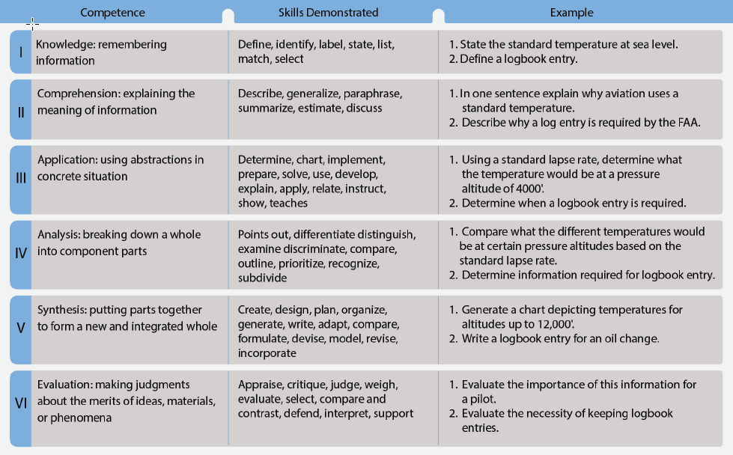

Slide 28
Effective Communication

Slide 29
Basic Elements
Source (speaker, writer, instructor)
Symbols (words or signs)
Receiver (listener, reader, student)

Slide 30
Source
Select and use appropriate language
Use meaningful symbols
Avoid unexplained acroynms
Be confident
Treat subject respectfully
Use material that is accurate, up-to-date, and interesting

Slide 31
Symbols
All communication, even written/spoken language, uses symbols
Symbols are perceived through three channels
  Visual (seeing)
  Auditory (hearing)
  Kinesthetic (touching, using, doing)

Slide 32
Receiver
Understand the receiver’s abilities (experience, culture)
Pitch your communication to the receiver’s attitudes
Use your receiver’s experiences. In aviation we have an advantage – students are usually highly motivated and come to us with a range of experience

Slide 33
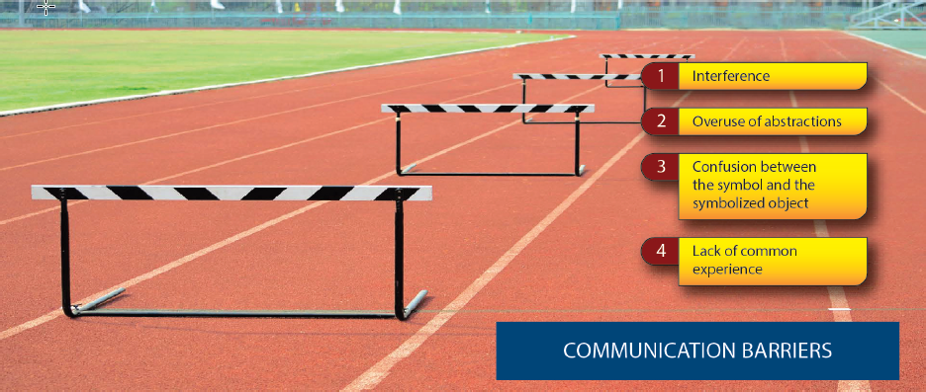
Barriers to Communication

Slide 34
Barriers to Communication
Message gets garbled, truncated, or overly complicated. Reduce by getting feedback from students to make sure the message was received as transmitted

Slide 35
Barriers to Communication
Use of general instead of specific terms means the teacher can say something that the students hear as something else.

Slide 36

Barriers to Communication

Slide 37
Barriers to Communication
Words are symbols that potentially can have more than one meaning. What does “stall” mean? A stalled engine? A stalled wing? (A place where you put your cow?)

Slide 38
Barriers to Communication
Words do not carry information the same way a truck carries bricks. There has to be a mutual vocabulary and background for communication to succeed.

Slide 39
The Teaching Process

Slide 40
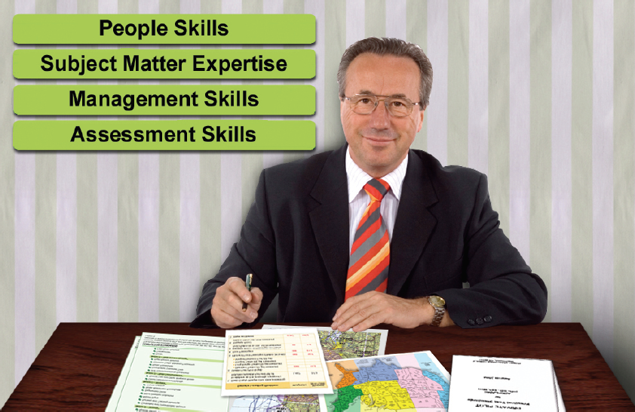

Slide 41
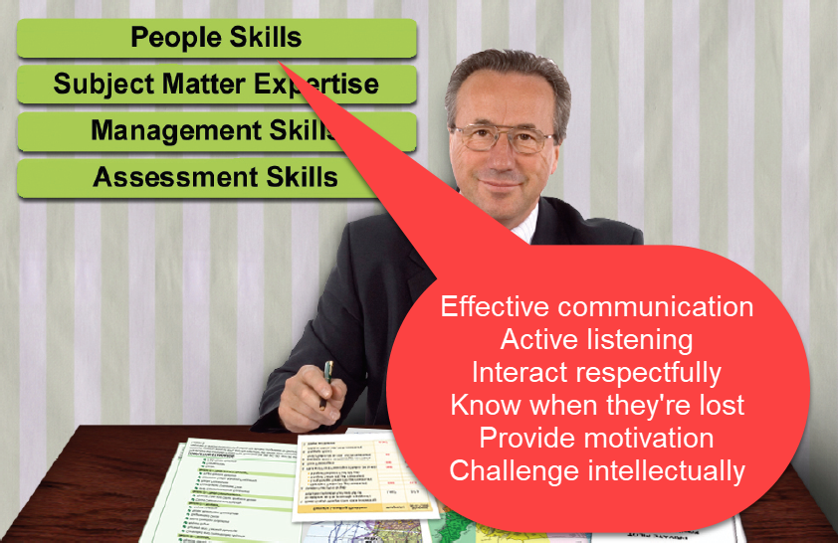

Slide 42
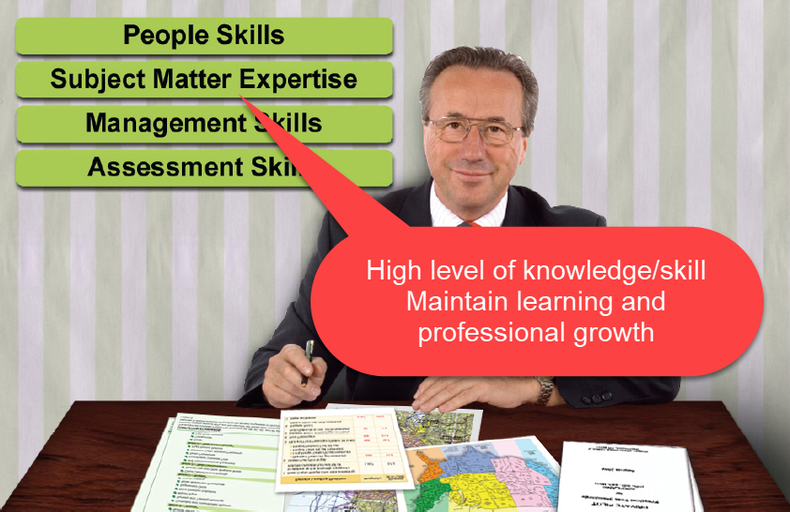

Slide 43
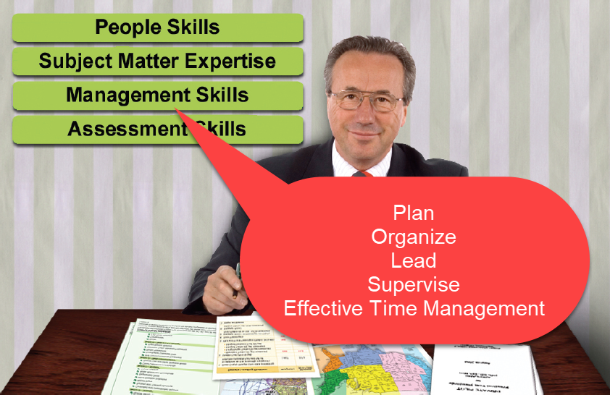

Slide 44
